Slide 1
Assessing Risk: Competition & Data
Module 4

Slide 2

Objectives
Quantitative risk analytics methods and techniques in risk assessment
Develop risk mitigation measures

Slide 3

Quantitative analysis answers:
What is the likelihood or probability of meeting the organization’s objectives?
How much contingency planning or mitigation actions are needed?
What individual risks contribute to overarching risk to the organization?

Slide 4
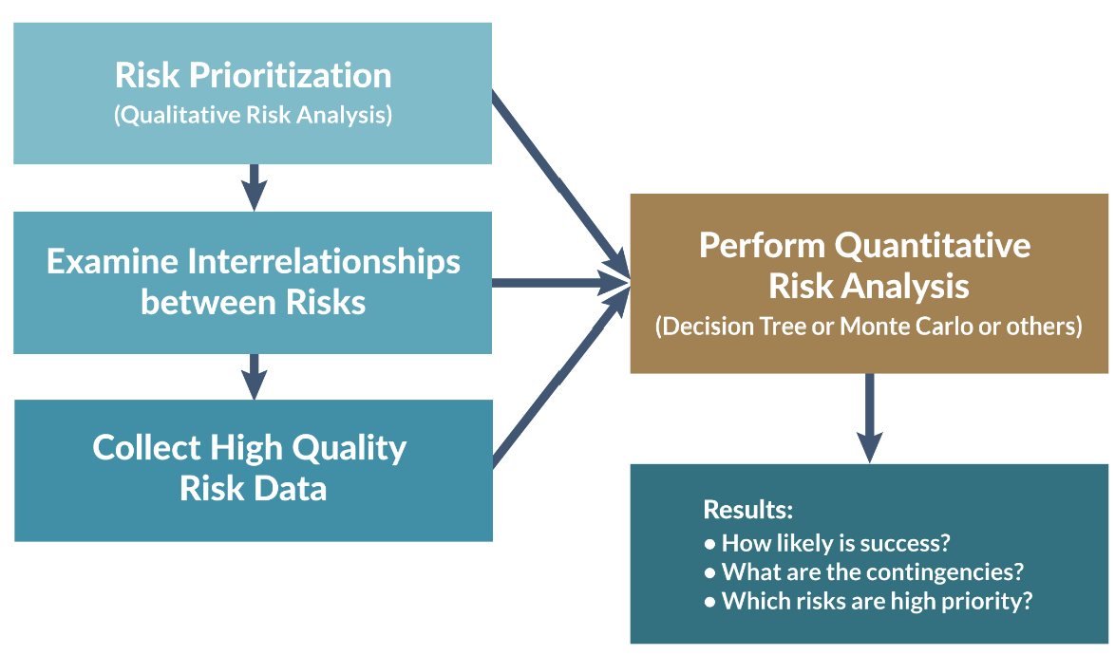
Process of Quantitative Risk Analysis

Slide 5
Quantitative Risk Assessment Techniques
Uses statistical models, simulation, and ML to estimate:
• Probability of risk events occurring
• Magnitude of potential impact
• Optimal mitigation strategies

Slide 6
Quantitative Risk Assessment Techniques
Data Sources for Market Entry Analysis
Structured Data
Competitor entry history (market, region, entry year, outcomes)
Macroeconomic indicators (GDP, interest rates, inflation)
Market metrics (market share, pricing, sales volume)
Operational data (customer churn, cost structure, supply chain performance)

Slide 7
Quantitative Risk Assessment Techniques
Data Sources for Market Entry Analysis
Unstructured Data (Qualitative)
News articles
Press releases
Earnings call transcripts
Social media sentiment
Expert reports and industry whitepapers

Slide 8
Quantitative Risk Assessment Techniques
Data Sources for Market Entry Analysis
Unstructured Data (Qualitative)
News articles
Press releases
Earnings call transcripts
Social media sentiment
Expert reports and industry whitepapers

Slide 9
Quantitative Modeling Techniques
Statistical Risk Models: relationships between risk drivers and outcomes.
Examples:
• Logistic regression for probability of competitor success
• Linear regression for impact on revenue
• Time-series models for market trend forecasting
Libraries:
• scikit-learn
• statsmodels
• Prophet (Meta)

Slide 10
Quantitative Modeling Techniques
Monte Carlo Simulation: Simulates thousands of scenarios to model uncertainty.
• Revenue impact of new competitors
• Pricing strategy risks
• Supply chain disruptions
Libraries:
• NumPy
• SciPy
• Chaospy
• SimPy

Slide 11
Quantitative Modeling Techniques
ML Risk Prediction: to predict future risk events.
Models: Random Forest, Gradient Boosting, Neural Networks
Predicting market entry success
Estimating market share loss
Detecting early warning signals
Libraries: scikit-learn, XGBoost, LightGBM, CatBoost

Slide 12
Rirk Visualization and Decision Support
• Risk heat maps
• Scenario comparison charts
• Probability distributions

Slide 13
Quantitative Risk Assessment Techniques
3-Point Estimate- optimistic, most likely and pessimistic estimates of risk cost.
Decision Tree Analysis- presents costs associated with different choices with respect to risk.
Expected Monetary Value (EMV)- calculate a contingency reserve for a project budget based on expected cost associated with opportunities and threats of the project .
Monte Carlo Simulation
Sensitivity Analysis
Fault Tree Analysis

Slide 14
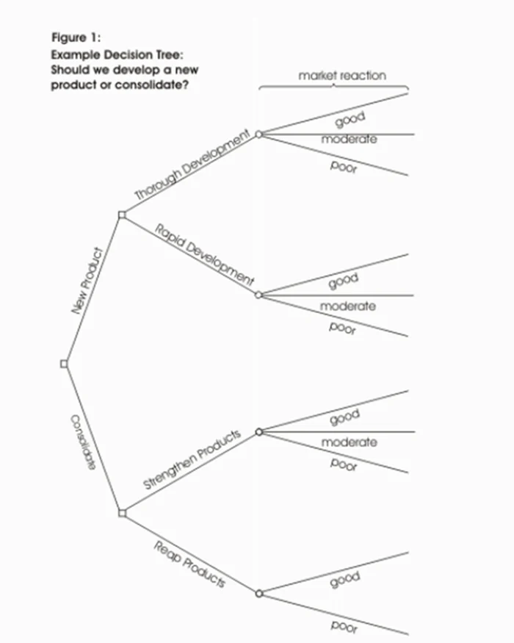
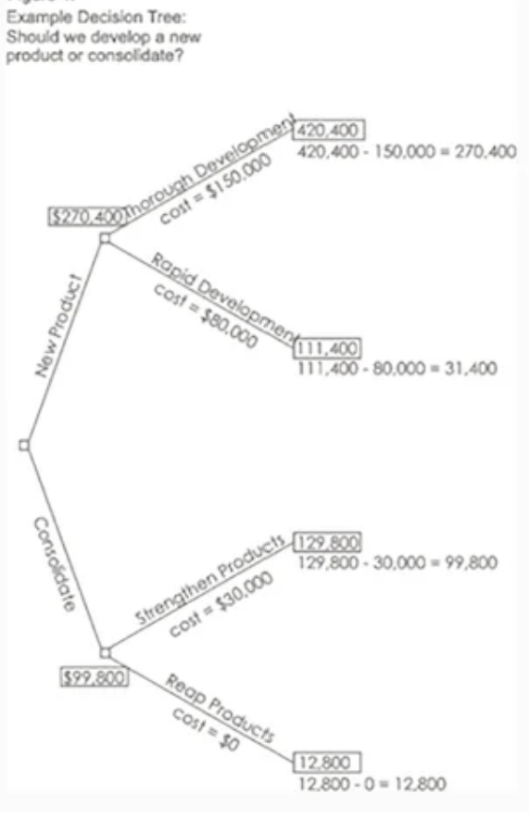
Decision Tree Analysis

Slide 15
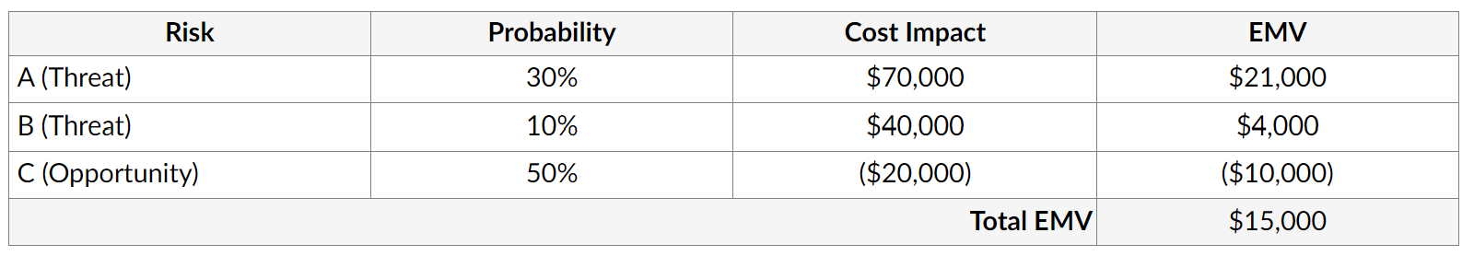
Expected Monetary Value (EMV)
Determine a contingency reserve for a project.
EMV = Probability X Cost Impact

Slide 16
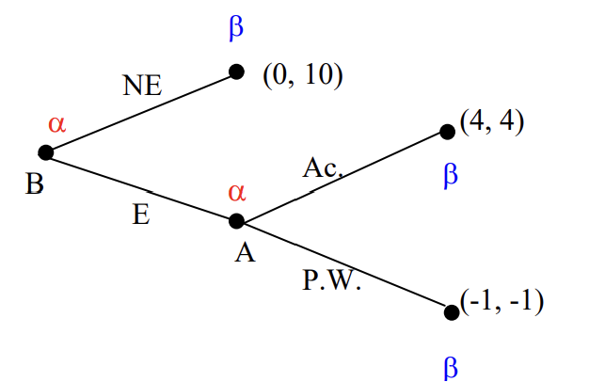
Decision Tree Analysis
Market entry game with imperfect information

Slide 17

Risk management techniques
Acceptance
Mitigation
Avoidance
Transfer

Slide 18
Output of Quantitative Risk Analysis
• Probability distributions of outcomes
• Scenario simulations
• Expected loss estimates
• Risk-adjusted decision recommendations

Slide 19

Note
Assess risks based on the controls
Risk mitigating is evolutionary

